Slide 1

Structuring observational assessment to promote learning in practice
12th JSWEC Conference
30th June – 2nd July 2010
Alan Murphy - Social Work Lecturer
Julie Laxton – ALPS Teaching Fellow
University of Leeds
Assessment and Learning in Practice Settings (ALPS) ©
http://www.alps-cetl.ac.uk
Notes:
Format of presentation
Background to ALPS
What ALPS is doing
……
Funded by the Higher Education Funding Council for England 74 “CETLS” £315m single largest funding programme to develop L&T,
To raise profile of L&T, awarded to already excellent institutions, based at the University of Leeds

Slide 2
ALPS CETL
Who we are?
A centre for excellence in teaching and learning (CETL) focussing on assessment and learning in practice settings. 5 Universities (Leeds, Leeds Metropolitan, Bradford, Huddersfield and York St John) crossing 16 health and social care professions
What was the aim of this programme?
  To achieve excellence in assessment and learning based on interprofessional Common Competency Maps, which can be delivered by mobile technology
  To ensure that students graduating from courses in health and social care were fully equipped to perform confidently and competently at the start of their professional careers
Assessment and Learning in Practice Settings (ALPS) ©
http://www.alps-cetl.ac.uk

Slide 3
ALPS developed 3 approaches to improving competence
and confidence in health and social care students;
Promoting interprofessional assessment of core
competences
Testing the viability of the use of mobile devices to deliver
assessment and learning in the practice setting
Encouraging service user and carer involvement
in student feedback
Student feedback from Social Work indicates more outcomes
than originally envisaged.
ALPS CETL
Assessment and Learning in Practice Settings (ALPS) ©
http://www.alps-cetl.ac.uk

Slide 4
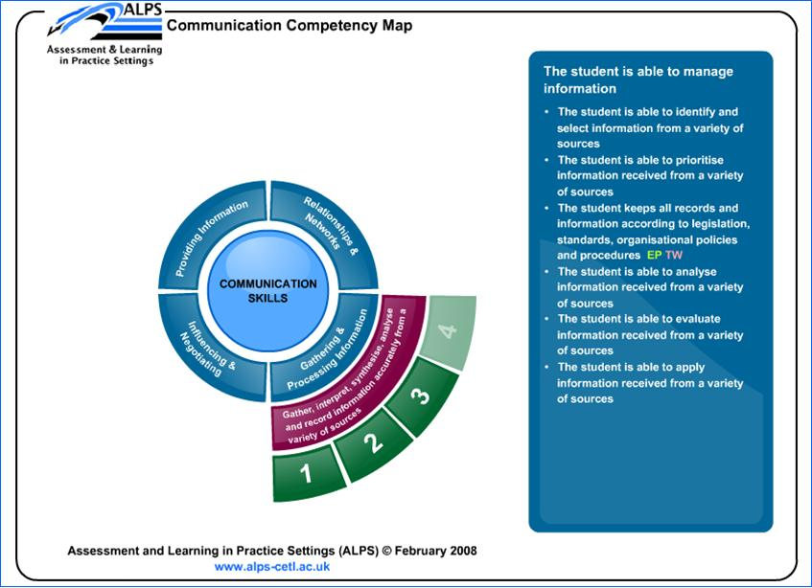
Three Maps; Communication: Team Working; Ethical Practice; http://www.alps-cetl.ac.uk/maps.html
Assessment and Learning in Practice Settings (ALPS) ©
http://www.alps-cetl.ac.uk

Slide 5
Five Assessment Tools; Developed out of the ALPS Common Competency maps
Demonstrating respect for service users during an interaction
Gaining Consent
Knowing when to consult or refer
Providing information
Working Inter-professionally
Within each tool there is scope for the following;
-Self assessment
-Peer assessment
-Practice assessor assessment
-Service user assessment
But not all sections have to be completed
Assessment and Learning in Practice Settings (ALPS) ©
http://www.alps-cetl.ac.uk
Notes:
8 international presentations (Singapore, South Africa, Canada, Hong Kong)
Presentations to PSRBs, eg.Society & College of Radiographers,
HE sector: Institute of Education, EARLI, Solstice
SU conference: Authenticity to Action
Awards
ALPS winners of 2: Handheld Learning 2009 award for innovation in HE/FE
Techworld 2008: Mobility project of the year (with T Mobile)
Shortlisted (to be awarded this week):
E-learning age award

Slide 6
Paper Based Tools
Paper versions of the 5 assessment tools were mapped to the National Occupational Standards for social work with completed examples
Workshops with students and with practice educators
Phase 1;Given out to all BA social work students 1st years and one 2nd year tutor group. Focus group held with 2nd year group
Phase 2; Given out to BA in all 3 years. Focus Groups with first year and third year
Preparation workshops with students and with practice educators in both phases
Assessment and Learning in Practice Settings (ALPS) ©
http://www.alps-cetl.ac.uk
Notes:
8 international presentations (Singapore, South Africa, Canada, Hong Kong)
Presentations to PSRBs, eg.Society & College of Radiographers,
HE sector: Institute of Education, EARLI, Solstice
SU conference: Authenticity to Action
Awards
ALPS winners of 2: Handheld Learning 2009 award for innovation in HE/FE
Techworld 2008: Mobility project of the year (with T Mobile)
Shortlisted (to be awarded this week):
E-learning age award

Slide 7
Date and place of assessment | Social Services Information Point
Questions for Student | Student statement | Examples of claims in relation to GSCC Code of Practice / Key Roles
Describe your interaction with a service user. | I took a telephone call on duty. The service user wanted to know about car badges I checked whether or not the service user was already known to us and whether or not they had any other needs that we might be able to help with. I was aware that sometimes straightforward requests might hide other issues and needs that could be discussed and may be more formally assessed under our legal obligations in relation to for instance the NHS&CC Act 1990 or the Carers, (Recognition and Services) Act 1995 and Carers (Equal Opportunities) Act 2004 I filled in the relevant forms and passed them on to the relevant colleague I discussed the work I did with an experienced colleague to check I had done things correctly | Key role 1 Prepare for and work with people Unit 1.3 Evaluate all information to identify the best form of initial involvement Key role 5 Manage social work practice Unit 14.3 Monitor and evaluate the effectiveness of your programme of work in meeting the organisational requirements and the needs of individuals, families, carers, groups and communities. Key role 6 Demonstrate professional competence Unit 19.3 Work within the principles and values underpinning social work practice. Unit 19.5 Use supervision and support to take action to meet continuing professional development needs. GSCC Code of Practice 6. Be accountable for the quality of their work and take responsibility for maintaining and improving their knowledge and skills.
Assessment and Learning in Practice Settings (ALPS) ©
http://www.alps-cetl.ac.uk
Notes:
8 international presentations (Singapore, South Africa, Canada, Hong Kong)
Presentations to PSRBs, eg.Society & College of Radiographers,
HE sector: Institute of Education, EARLI, Solstice
SU conference: Authenticity to Action
Awards
ALPS winners of 2: Handheld Learning 2009 award for innovation in HE/FE
Techworld 2008: Mobility project of the year (with T Mobile)
Shortlisted (to be awarded this week):
E-learning age award

Slide 8
Focus group outcomes
Students liked;
- They understood how the observations in practice related to their NOS and produced evidence for their portfolio
  Consistency of gathering evidence across a range of activity
  More confidence in asking for feedback; particularly from service users
  Encouragement of analysis and reflection
  Student control over the assessment feedback process
  Higher quality of evidence for portfolio
Some resistance amongst some practice educators, reported by students – workload, used to using other form
Assessment and Learning in Practice Settings (ALPS) ©
http://www.alps-cetl.ac.uk
Notes:
8 international presentations (Singapore, South Africa, Canada, Hong Kong)
Presentations to PSRBs, eg.Society & College of Radiographers,
HE sector: Institute of Education, EARLI, Solstice
SU conference: Authenticity to Action
Awards
ALPS winners of 2: Handheld Learning 2009 award for innovation in HE/FE
Techworld 2008: Mobility project of the year (with T Mobile)
Shortlisted (to be awarded this week):
E-learning age award

Slide 9
Focus group feedback
I found (the questions) really helpful because with some of the service users that I was working with, when someone asked; ‘What do you think of…?’ They didn’t know what to say so it gave .. good guidance for them to know what kind of things we wanted them to look for.
My practice placement educator, she likes the guidance, you know … what to write.
My practice teacher …… she didn’t use it but the next person who did my direct observation used it and then she saw that report and said that next time we would use it.
There’s an increased emphasis on our reflective practice so it’s very good for that.
I think I would have found that really difficult (if the form didn’t have the NOS and examples of how to use them)… looking at the examples that were given it them made me think ‘ah right that does meet that role’ when I would have thought my work actually wasn’t meeting as many roles as it was. It helped me to reflect and actually I’m doing a lot more than I think I am, so I think I would’ve found it difficult to do…….. I would agree with that (several students)
It’s more focused evidence as well.
Consistency of feedback across the three focus groups over two placements and three
academic levels
Assessment and Learning in Practice Settings (ALPS) ©
http://www.alps-cetl.ac.uk
Notes:
8 international presentations (Singapore, South Africa, Canada, Hong Kong)
Presentations to PSRBs, eg.Society & College of Radiographers,
HE sector: Institute of Education, EARLI, Solstice
SU conference: Authenticity to Action
Awards
ALPS winners of 2: Handheld Learning 2009 award for innovation in HE/FE
Techworld 2008: Mobility project of the year (with T Mobile)
Shortlisted (to be awarded this week):
E-learning age award

Slide 10
Bibliography
BOUD D (2000) Sustainable assessment: rethinking assessment for the Learning Society. Studies in Continuing Education. 22:2.
FALCHIKOV N (2005) Improving Assessment Through Student Involvement. Routledge Farmer Oxford
HOLT et al (2010) Identifying Common Competencies in Health and Social Care: an example of multi-institutional and interprofessional working. Nurse Education Today. 30:3
HUMPHREY C (2007) Observing Students’ Practice (through the looking glass and beyond) Social Work Education 11:2
Building a Safe, Confident Future: the final report of the Social Work Taskforce (2009) http://publications.dcsf.gov.uk accessed 24.06.10
Assessment and Learning in Practice Settings (ALPS) ©
http://www.alps-cetl.ac.uk
Notes:
8 international presentations (Singapore, South Africa, Canada, Hong Kong)
Presentations to PSRBs, eg.Society & College of Radiographers,
HE sector: Institute of Education, EARLI, Solstice
SU conference: Authenticity to Action
Awards
ALPS winners of 2: Handheld Learning 2009 award for innovation in HE/FE
Techworld 2008: Mobility project of the year (with T Mobile)
Shortlisted (to be awarded this week):
E-learning age award

Slide 11
Contacts
If you are interested and would like to find out more or explore the use of these tools please get in touch;
Alan Murphy; a.s.murphy@leeds.ac.uk
Julie Laxton; j.c.laxton@leeds.ac.uk
www.alps-cetl.ac.uk
Assessment and Learning in Practice Settings (ALPS) ©
http://www.alps-cetl.ac.uk
Notes:
8 international presentations (Singapore, South Africa, Canada, Hong Kong)
Presentations to PSRBs, eg.Society & College of Radiographers,
HE sector: Institute of Education, EARLI, Solstice
SU conference: Authenticity to Action
Awards
ALPS winners of 2: Handheld Learning 2009 award for innovation in HE/FE
Techworld 2008: Mobility project of the year (with T Mobile)
Shortlisted (to be awarded this week):
E-learning age award

